Slide 1
The Mechanics of the Elbow
Example 1
Milan S. Kovačević
Faculty of Science, Department of Physics
University of Kragujevac
Serbia
e-mails: kovac@kg.ac.rs
milan.kovacevic@pmf.kg.ac.rs
Foča, BiH, 2022.

Slide 2
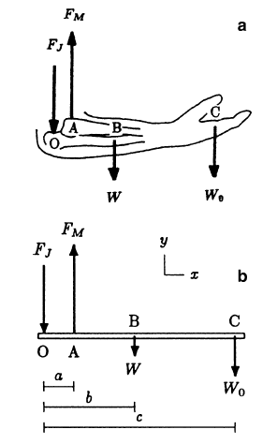
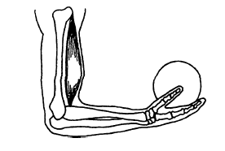
Forces acting on the lower arm
The elbow is fixed to a right angle and an object is held in the hand.
The forces acting on the forearm is shown in Figure and free body diagram of the forearm is shown on a mechanical model.
This model assumes that
the biceps is the major flexor and that the line of action of
the tension (line of pull) in the biceps is vertical.
Foča, BiH, 2022.

Slide 3
Mechanical model - description
Point O designates the axis of rotation of the elbow joint, which is assumed to be fixed for practical purposes.
Point A is the attachment of the biceps muscle on the radius, point B is the center of gravity of the forearm, and point C is a point on the forearm that lies along a vertical line passing through the center of gravity of the weight in the hand.
The distances between point O and points A, B, and C are measured as a, b, and c, respectively.
W_{o} is the weight of the object held in the hand and W is the total weight of the forearm.
F_{M} is the magnitude of the force exerted by the biceps on the radius, and F_{J} is the magnitude of the reaction force at the elbow joint. Notice that the line of action of the muscle force is assumed to be vertical.
The gravitational forces are vertical as well.
Therefore, for the equilibrium of the lower arm, the line of action of the joint reaction force must also be vertical (a parallel force system).
Foča, BiH, 2022.

Slide 4
The task
The task in this example is to determine the magnitudes of the muscle tension and the joint reaction force at the elbow.
The unknowns are the magnitudes F_{M} and F_{J} of the muscle and joint reaction forces.
Foča, BiH, 2022.

Slide 5
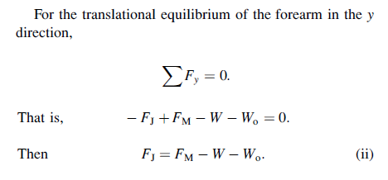
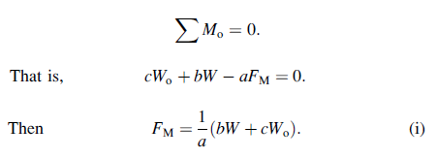
The solution
Considering the rotational equilibrium of the forearm about the elbow joint and assuming the (cw) direction is positive:
Foča, BiH, 2022.

Slide 6
The Solution
For given values of geometric parameters a, b, and c, and weights W and W_{o}, Eqs. (i) and (ii) can be solved for the magnitudes of the muscle and joint reaction forces. For example, assume that these parameters are given as follows: a=4cm; b=15cm; c=35cm; W=20N, and W_{o} =80N. Then from Eqs. (i) and (ii):
Foča, BiH, 2022.

Slide 7
Remarks
The numerical results indicate that the force exerted by the biceps muscle is about ten times larger than the weight of the object held in the position considered.
Relative to the axis of the elbow joint, the length a of the lever arm of the muscle force is much smaller than the length c of the lever arm enjoyed by the load held in the hand. The smaller the lever arm, the greater the muscle tension required to balance the clockwise rotational effect of the load about the elbow joint.
Therefore, during lifting, it is disadvantageous to have a muscle attachment close to the elbow joint. However, the closer the muscle is to the joint, the larger the range of motion of elbow flexion–extension, and the faster the distal end (hand) of the forearm can reach its goal of moving toward the upper arm or the shoulder.
Foča, BiH, 2022.

Slide 8
Thank you for your atention!
Dr Milan Kovačević, Full Professor
Faculty of Science, Department of Physics
University of Kragujevac
kovac@kg.ac.rs
milan.kovacevic@pmf.kg.ac.rs
Foča, BiH, 2022.

